Slide 1
Beijing 2022 Paralympic winter games
Education pack

Slide 2
Welcome
For learners
For Teachers
What are the Paralympic Winter Games? Why are they important? Where are some of the amazing venues where the Paralympic Winter Games will take place? Who are the Para athletes who will travel to the Paralympic Winter Games to represent New Zealand?
Find out the answers to questions like these, play games and quizzes, and learn how to get involved!
The Beijing 2022 Paralympic Winter Games is an awesome chance to showcase the world of Para sport. We’ve compiled this resource in response to teachers seeking to know how to bring the Paralympic Winter Games to learners in their own homes or classrooms.
This document contains an abundance of information and suggestions on how to get engaged with the New Zealand Paralympic Team and the Beijing 2022 Paralympic Winter Games. From fun and exciting activities, to watching the action LIVE on TV, there is something for everyone. We have included some excellent links to resources and information about the Team.

Slide 3
Connect with Beijing 2022

Slide 4
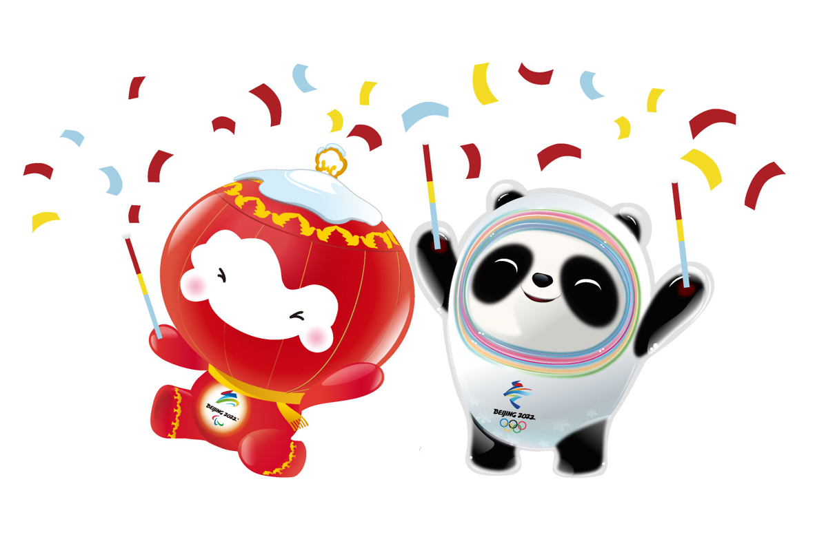
QUICK FACTS
WHEN
5 – 14 March 2022 (NZT)
VENUE
Beijing, China
HOW CAN I WATCH?
Watch coverage every day from 5 March on TVNZ DUKE (Freeview 13, Sky 23 and live-streamed on TVNZ OnDemand).
WHO TAKES PART?
Around 600 Para athletes from about 50 countries, across 6 Para sports.
These sports include, Para alpine skiing, Para biathlon, Para cross-country skiing, Para ice hockey, Para snowboard, and Wheelchair curling.
OUR PARA ATHLETES​
Adam Hall, Corey Peters, Aaron Ewen​
EVENT TIMINGS
Events with New Zealanders take place 3pm – 8pm NZT.

Slide 5
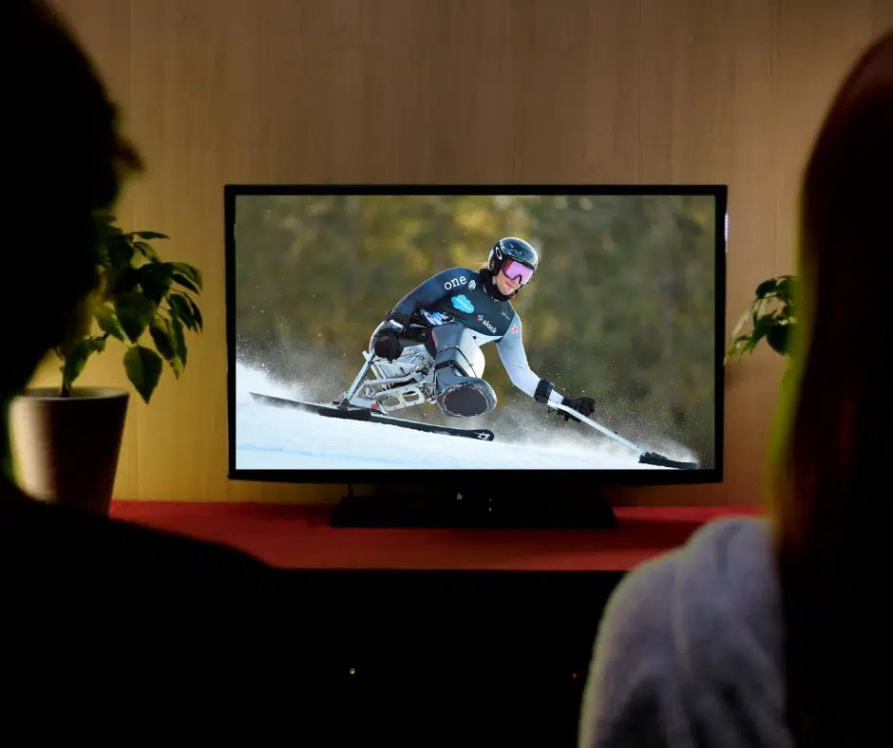
How can I watch?
Watch all the action LIVE on TVNZ Duke [Freeview 13 | SKY 23 | Streamed live on TVNZ OnDemand.
For the first time, New Zealanders can watch every Beijing 2022 Paralympic Winter Games event, with live and delayed coverage shown from 10 am – 2 am (approx.) 5th – 13th March NZT.
Each morning after a New Zealand Paralympian competition day, TVNZ will cover our Paralympians, showcasing their best moments in competition on TVNZ 1 Breakfast at 6 am, 7 am, and 8 am.
Click HERE for more broadcast information.

Slide 6
Check out the schedule
Below is the NZ Paralympic Team schedule. Click HERE for more information and other sports on our website.
MARCH 2022
Opening
Ceremony 1am
Downhill
3pm
TUE 1
WED 2
THU 3
FRI 4
SAT 5
Super G
3pm
Super
Combined
Part 1: 2:55pm
Part 2: 7:10pm
Giant Slalom
Run 1: 2:55pm
Run 2: 6:55pm
Slalom
Run 1: 2:55pm
Run 2: 6:25pm
SUN 6
MON 7
TUE 8
WED 9
THU 10
FRI 11
SAT 12
Closing Ceremony
1am
SUN 13
MON 14
TUE 15
WED 16
THU 17
FRI 18
SAT 19

Slide 7
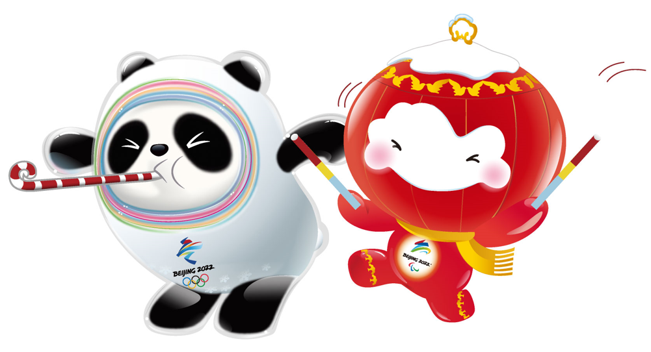
Join the action
Connect with the excitement and stay up to date with all the latest information and results on Facebook, Instagram, LinkedIn and Twitter!
Access the daily schedule of events and check out the Para athletes’ profiles on the NZ Team app. Go to the App Store/Play Store and search NZ Team to download this app. If you already have the app downloaded, you will need to update to the latest version to see the Paralympic Winter Games content.
Join the Kiwi Crew! Be the first to receive the latest news and exclusive content from Paralympics New Zealand by becoming a member of the Official Supporters Club of the New Zealand Paralympic Team. Sign up HERE.
Create a snowstorm of support on our website OR purchase a PNZ backpack or hoodie.

Slide 8
Meet the team

Slide 9
Adam hall Paralympian #158
Para sport: Para alpine skiing
Classification: LW1
Previous Paralympic Winter Games: 4
Paralympic Medals: 2x Gold, 1x Bronze
Favourite events: Slalom & Super Combined
Read Adam’s full Paralympian bio

Slide 10
Corey peters Paralympian #188
Para sport: Para alpine skiing
Classification: LW12-1
Previous Paralympic Winter Games: 2
Paralympic Medals: 1x Silver, 1x Bronze
Favourite events: Downhill & Giant Slalom
Read Corey’s full Paralympian bio

Slide 11
Aaron ewen
Para sport: Para alpine skiing
Classification: LW11
Previous Paralympic Winter Games: 0
Favourite event: Giant Slalom
Renowned for: Speed and X-Factor
Read a great article on Aaron

Slide 12
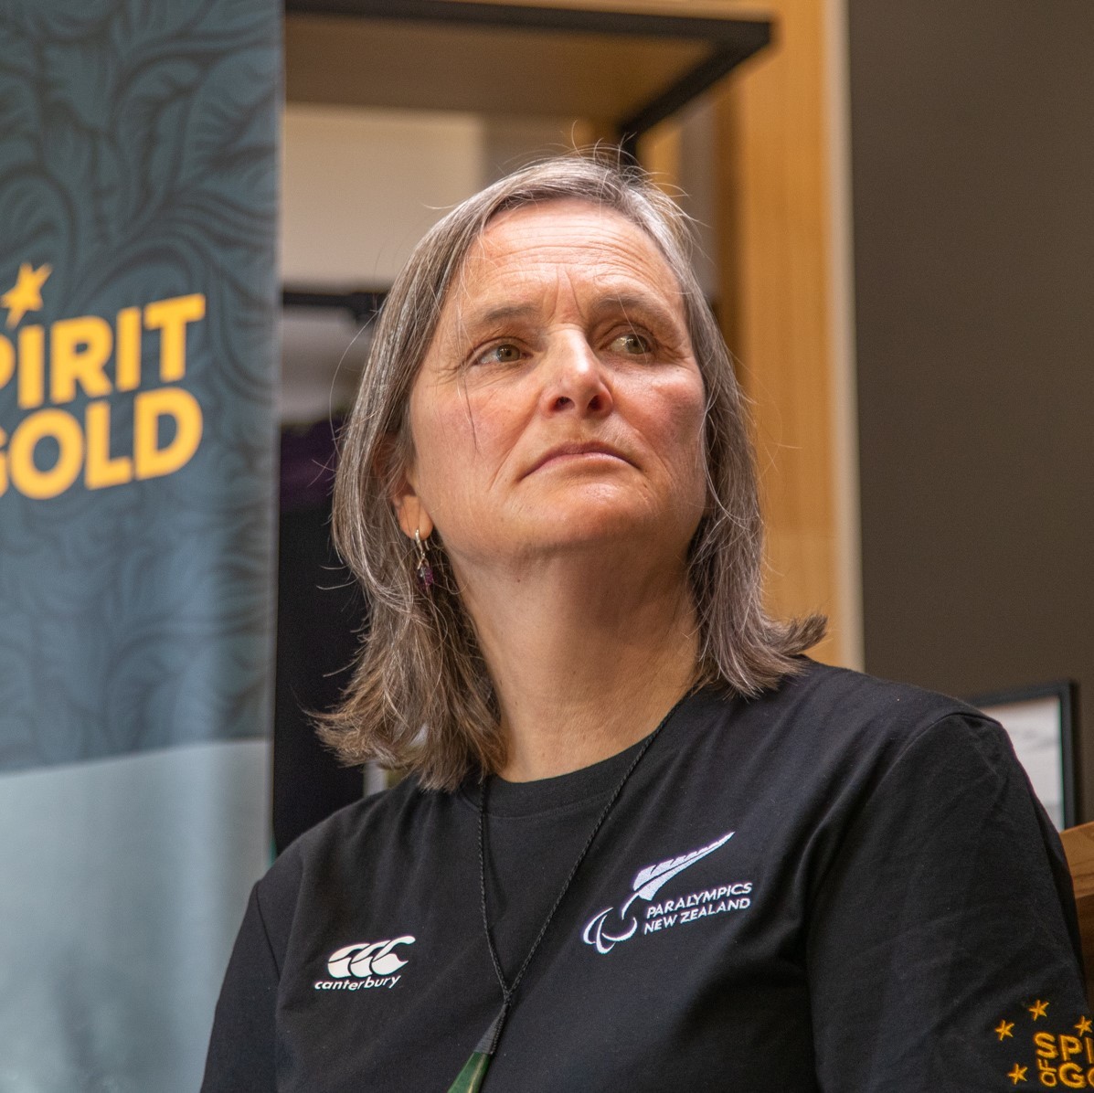
Support staff
There are many key people behind the scenes that are integral to preparing the Para athletes for competition. Click here to learn about our support staff.
Jane Stevens, Chef de Mission
Lynette Grace, Deputy Chef de Mission
Ben Adams, Head Coach
Scott Palmer, Assistant Coach
Dr. Bruce Hamilton, Medical Lead
Graeme White, Performance Physiotherapist
Curtis Christian, Wax & Equipment Technician
Jane Stevens, Chef de Mission. Click to find out more about Jane.
Click here to read about Jane’s preparation for Beijing

Slide 13
Get in touch with the team!
Share a message of support for the NZ Paralympic Team by emailing team@paralympics.org.nz
Messages will be collated and shared at the Paralympic Village throughout Beijing 2022.
They would love to hear from you!

Slide 14
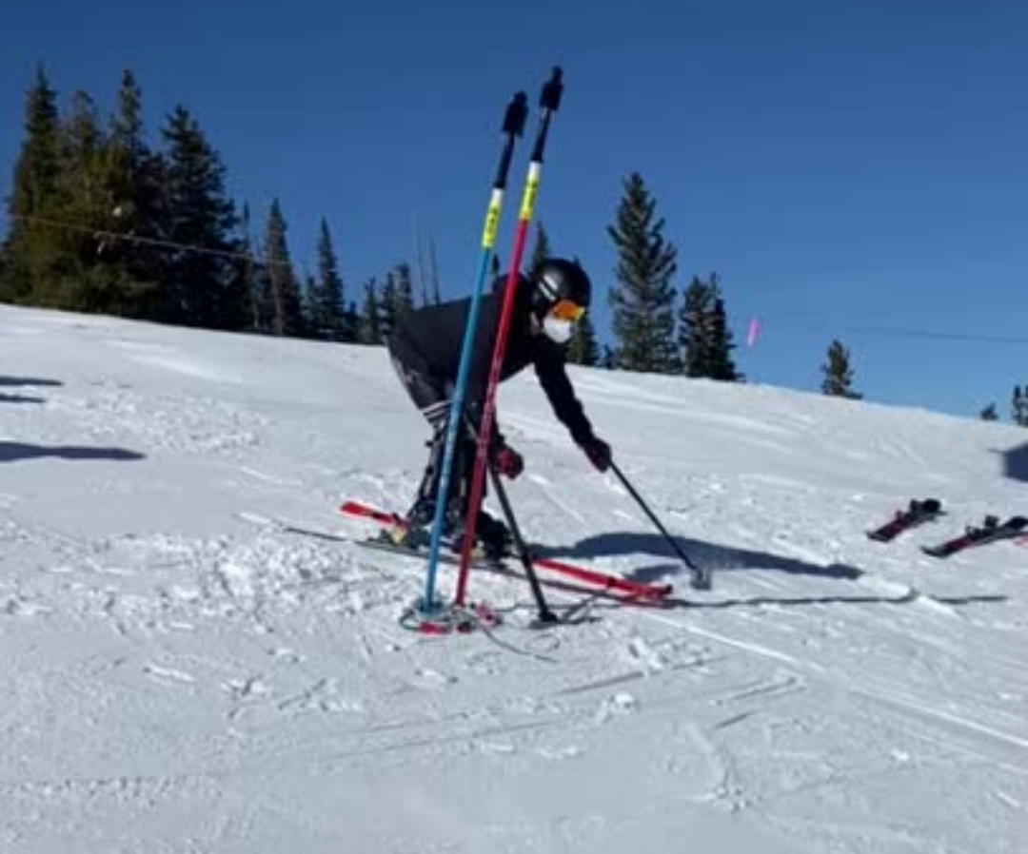
Behind the scenes footage
CLICK HERE to see The New Zealand Paralympic Team training at Winter Park, Colorado ahead of the Beijing 2022 Paralympic Winter Games.
Para alpine skiers can reach speeds of around 100km/h!
What else can you think of that can go that fast?

Slide 15
Learn about para sport

Slide 16
History
Winter sports for disabled athletes gradually developed after World War II, as a large numbers of injured soldiers and civilians tried to return to their skiing activities.
New Zealand first competed at the Paralympic Winter Games in Geilo, Norway 1980 (pictured).
Click here to learn more about New Zealand’s history at the Paralympic Winter Games.
Check out the next slide to see some retro New Zealand Paralympian outfits!

Slide 17
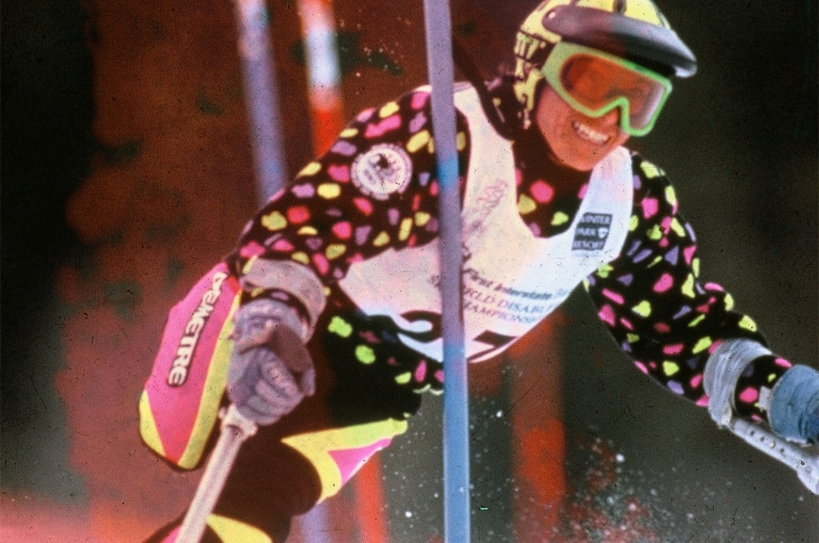
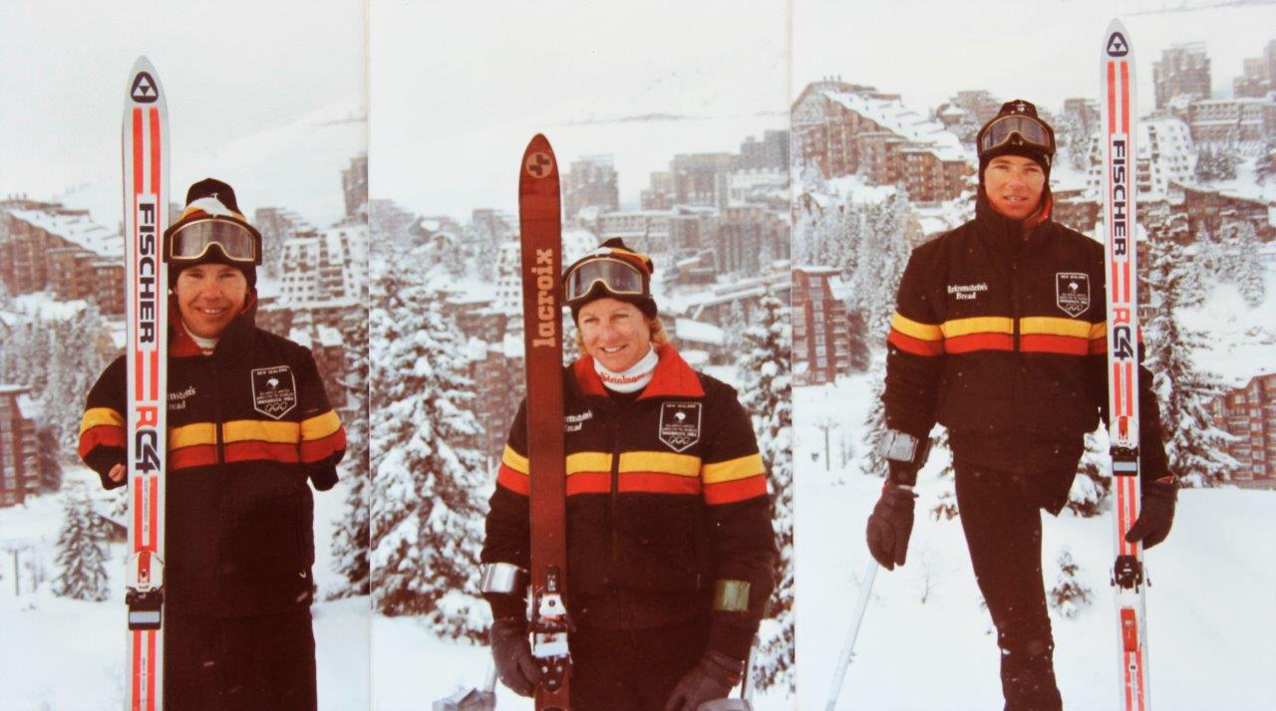
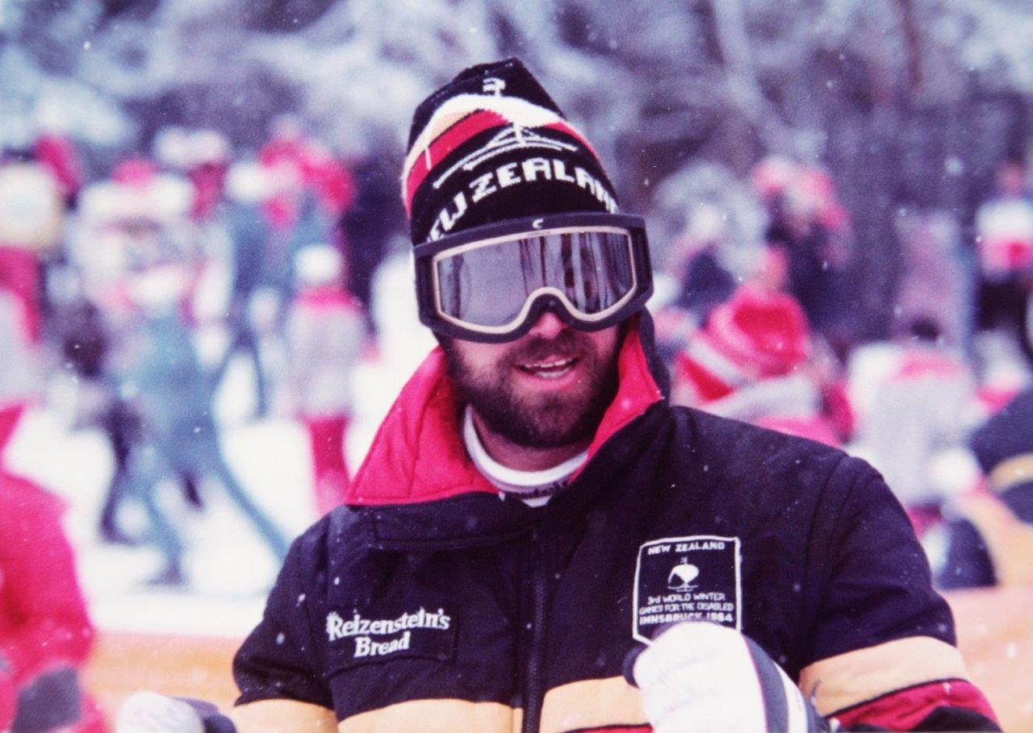
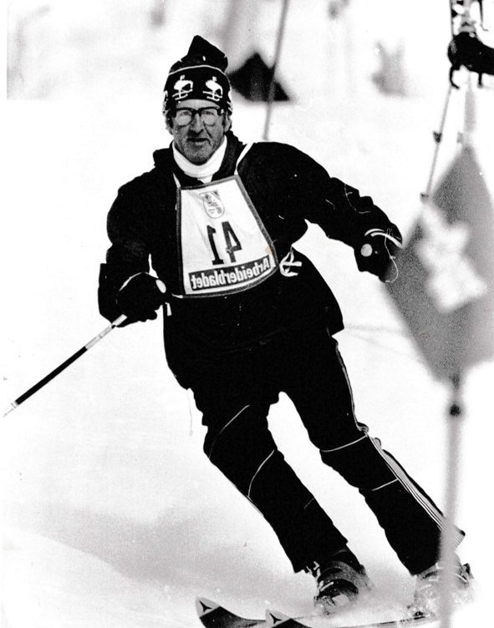
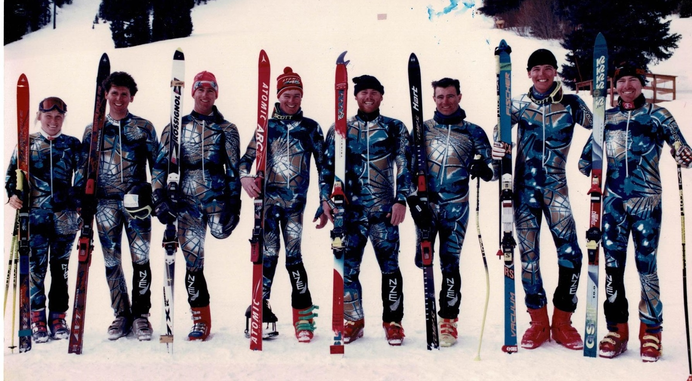
WHAT’S YOUR FAVOURITE
NZ PARALYMPIC TEAM UNIFORM?

Slide 18
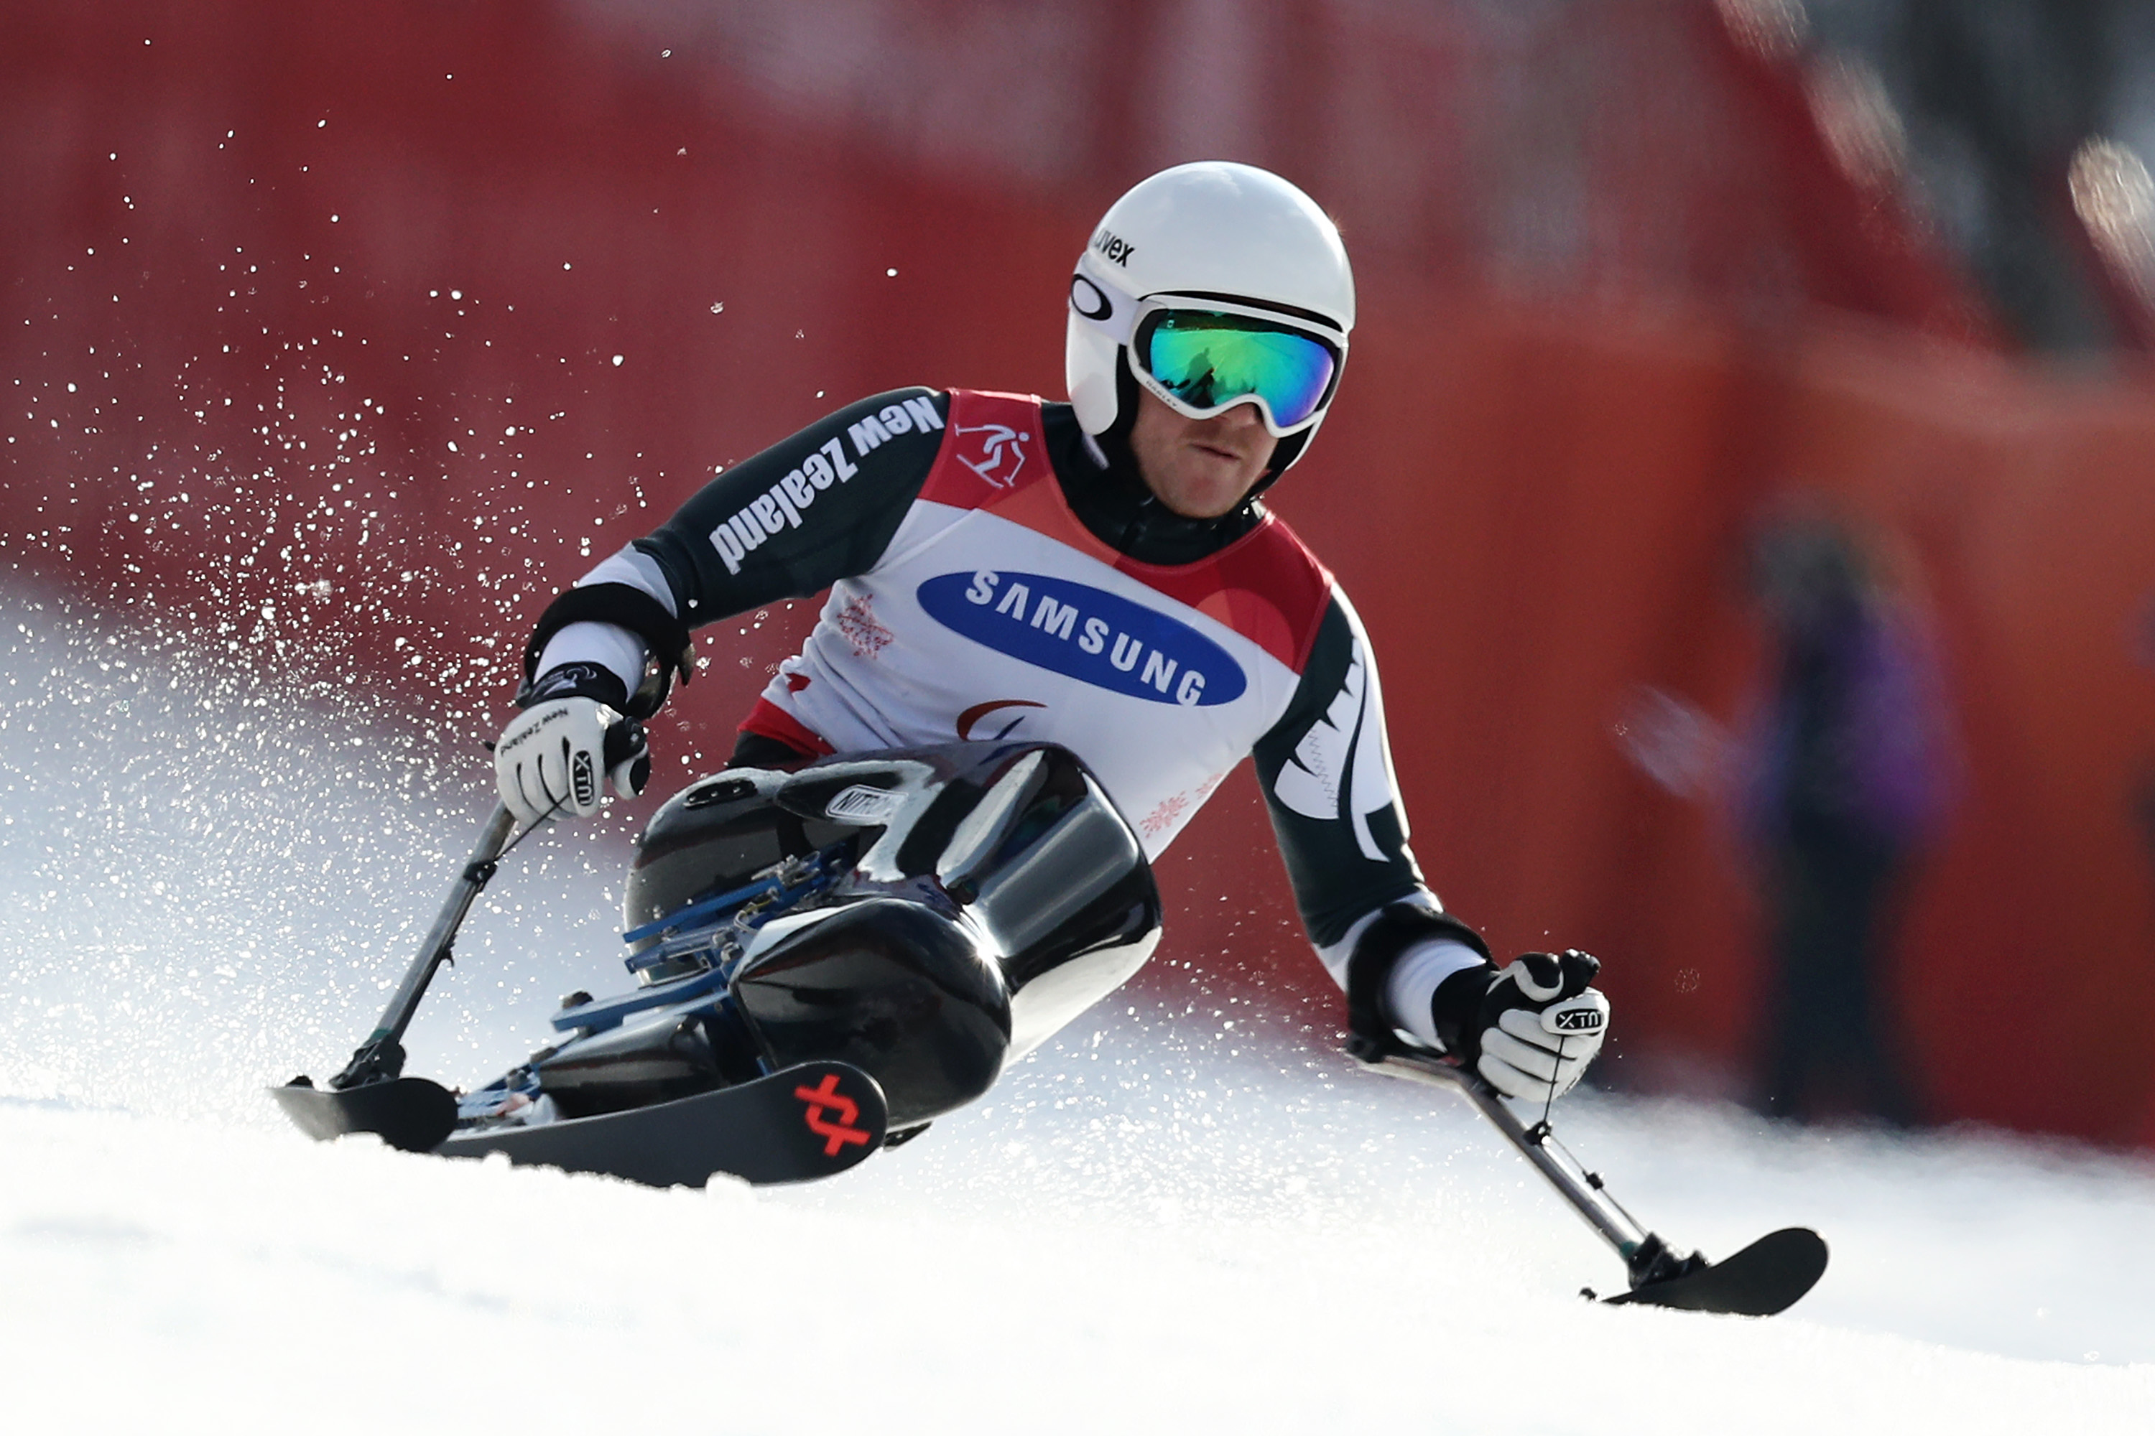
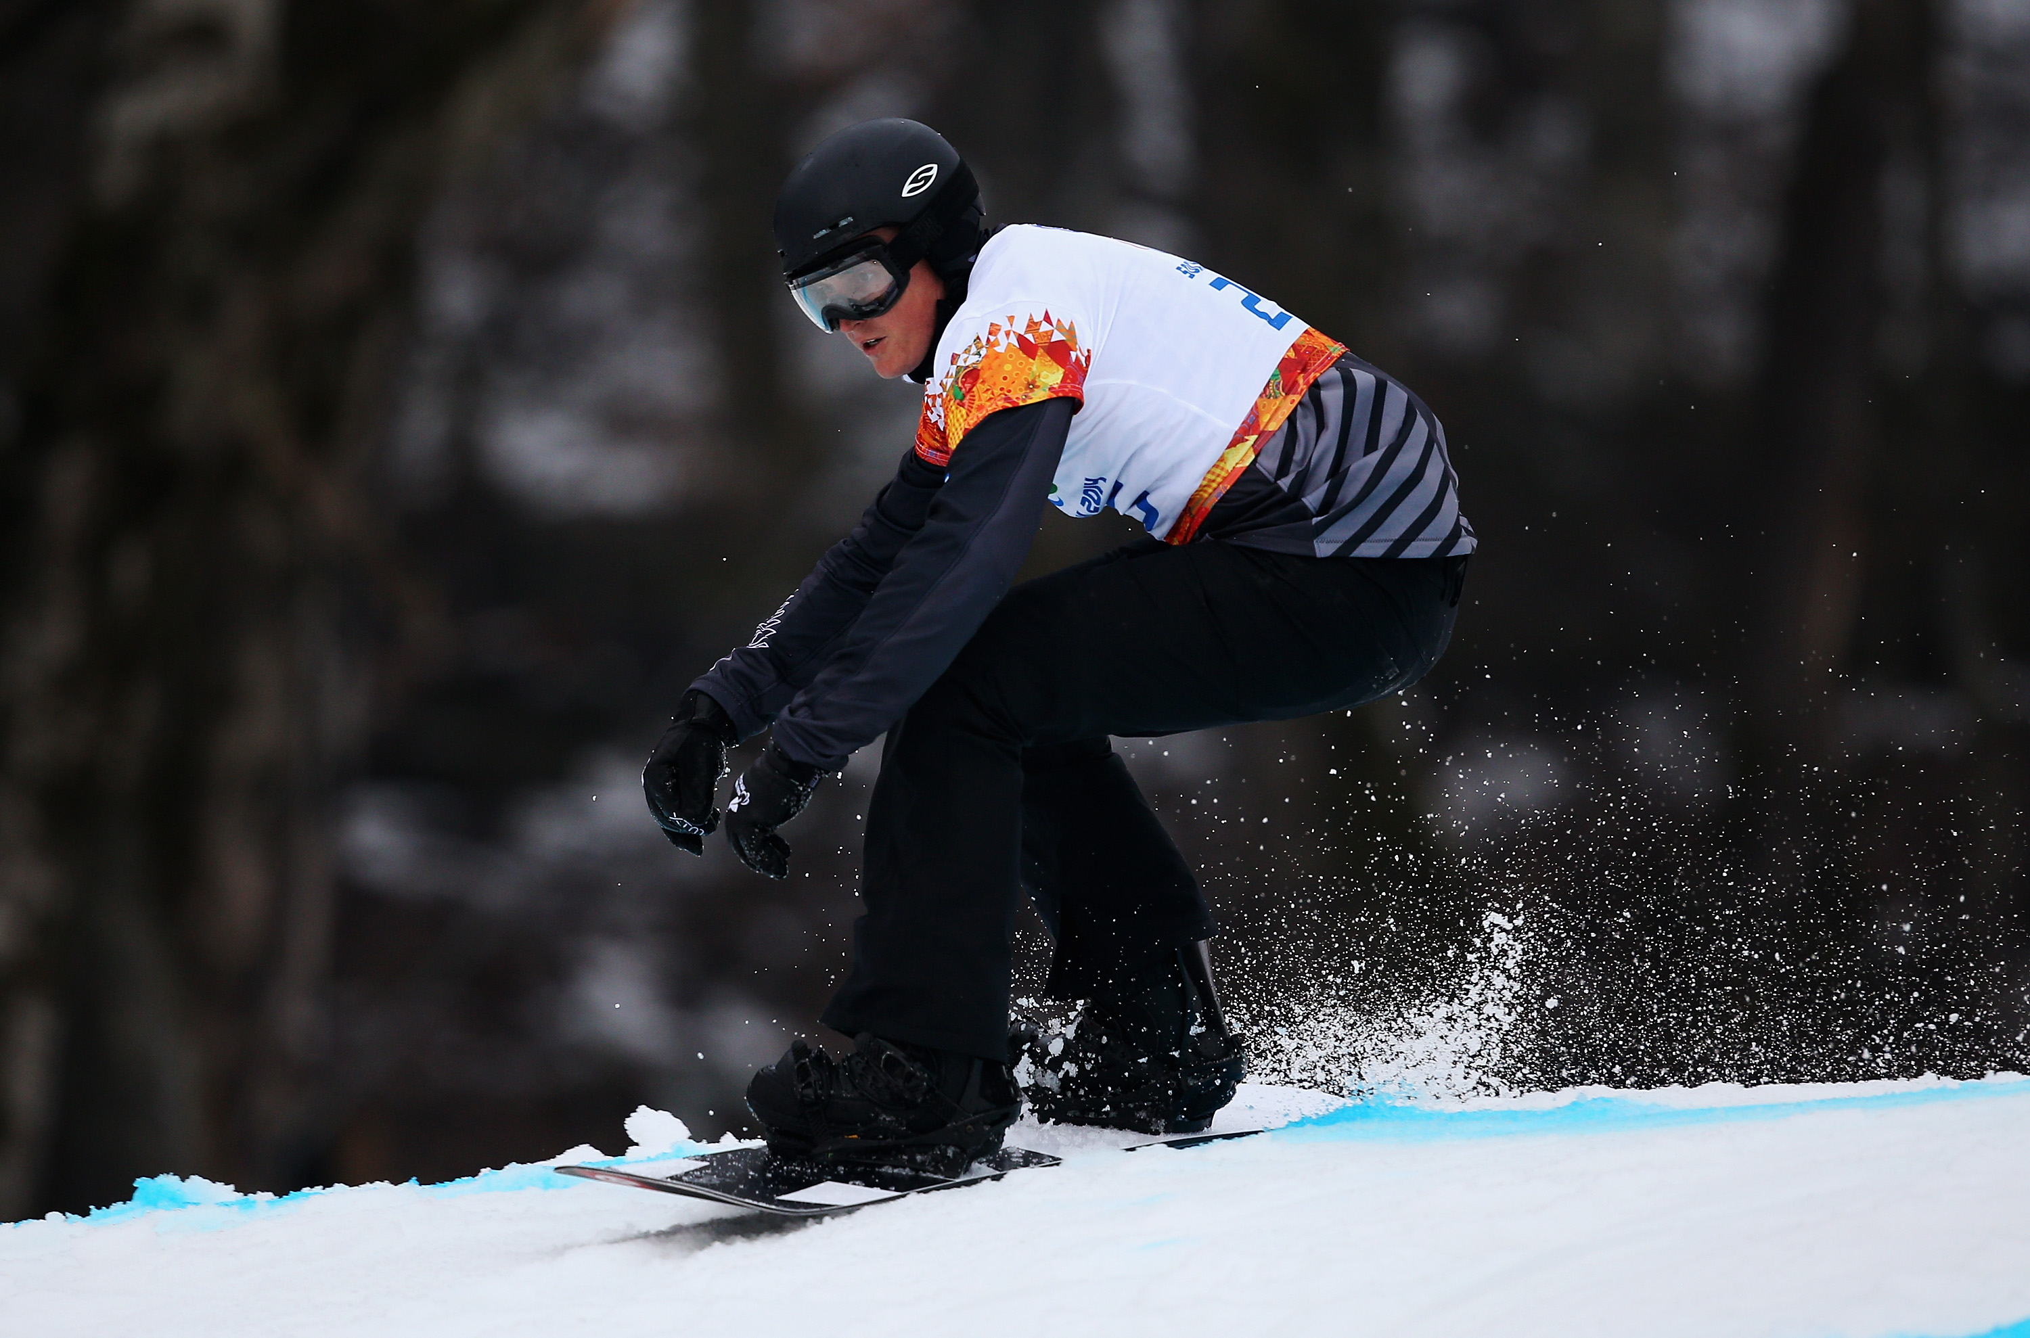
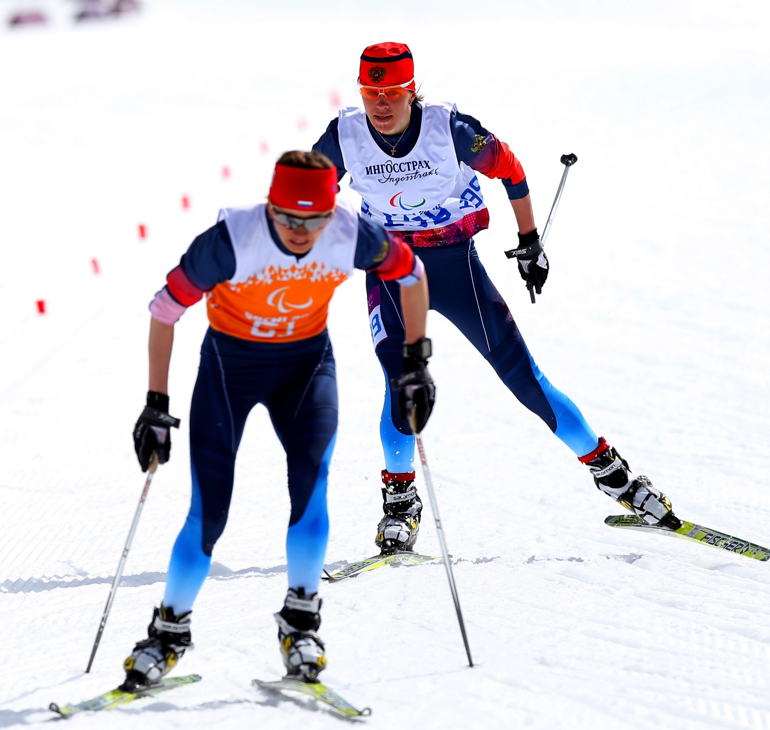
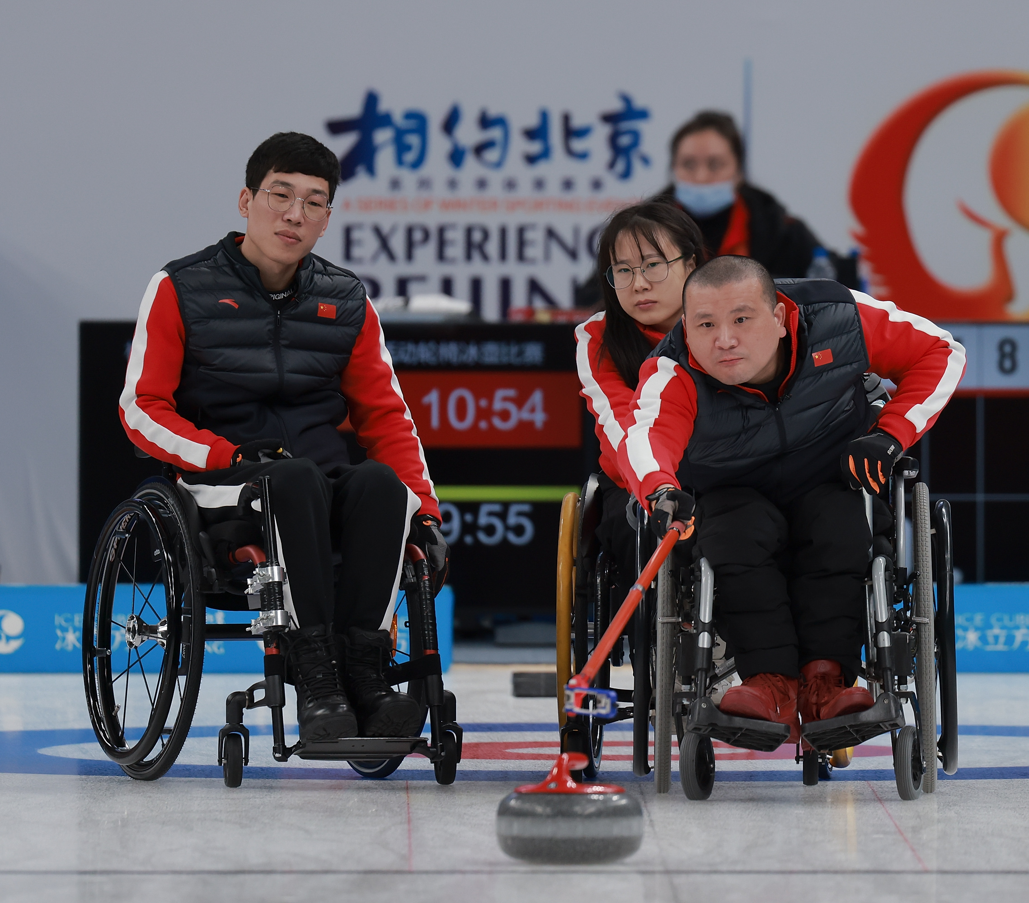
Winter para sports
There are six officially recognised winter Para sports that will feature at the Beijing 2022 Paralympic Winter Games.
Click the image to find out more!
Para alpine skiing
Para snowboard
Para cross-country skiing
Para ice hockey
Para biathlon
Wheelchair curling

Slide 19
Classification what is it?
Classification is integral to Para sport as it provides a structure for fair and equitable competition.
Para athletes with an eligible impairment are grouped into sport classes based on the impact their impairment has on the sport performance.
We have a comprehensive Classification section on our website if you would like to learn more!
An introductory video into classification.

Slide 20
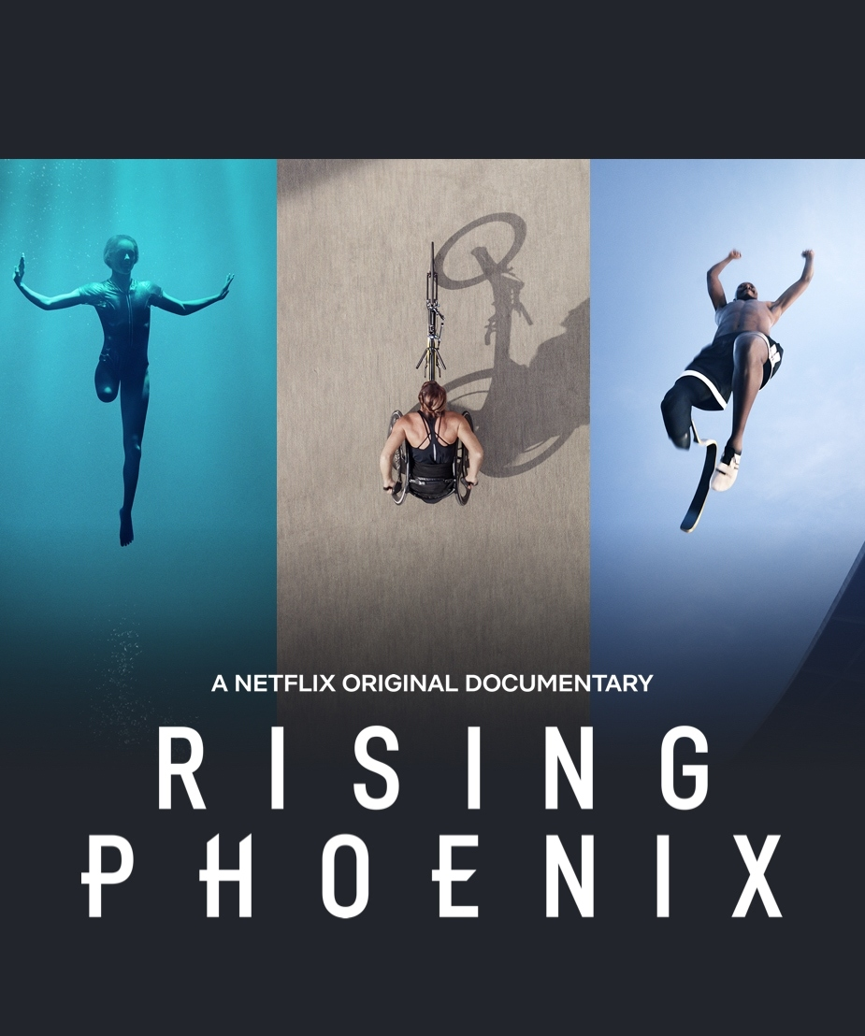
Rising phoenix
Rising Phoenix is a 2020 documentary film that tells the stories of nine Paralympians and their journeys in competition.
Elite Para athletes and insiders reflect on the Paralympic Games and examine how they impact a global understanding of disability, diversity and excellence.
Rising Phoenix is available on Netflix.
View the trailer.

Slide 21
#Wethe15
Launched at the Tokyo 2020 Paralympic Games, WeThe15 is sport’s largest ever human rights movement to end discrimination.
Persons with disabilities are 15% of our world. They are part of human diversity. In New Zealand that number is 24%.
Since its launch, the WeThe15 movement has reached 6.2 billion people – almost 80% of the world’s population!
TED TALK #WeThe15 SHORT FILM

Slide 22
Disability Awareness
FOR KAIAKO TEACHERS
Disability awareness activities
Paralympic School Day
Get your tamariki and rangatahi trying out activities to gain insights into everyday activities with a disability and reflecting on disability.
This great resource was developed by PNZ and Asia New Zealand Foundation.
The International Paralympic Committee created the ‘Paralympic School Day’. This is a fantastic resource packed with information and activities to educate students on Paralympic sport, individual differences and disability issues.
Disability Awareness Kaiako Teacher Activities
Paralympic School Day Activities

Slide 23
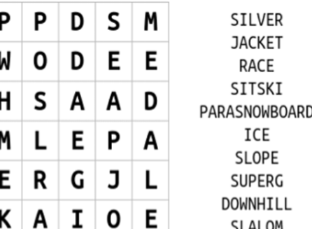
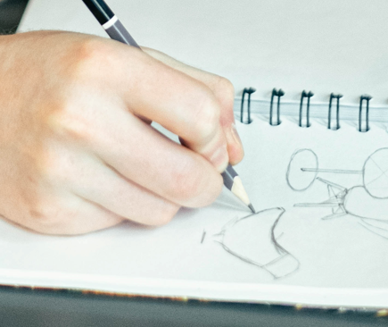
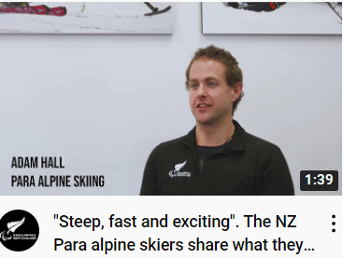
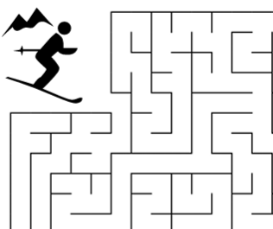
Activities for tamariki and rangatahi learners
Winter Paralympics Wordsearch | Draw a Para alpine skier | Watch interviews with Adam, Corey and Aaron | Read “30 things you need to know about the Paralympic Winter Games”
Help the Para alpine skier reach the gold medal | How much do you know about China? Try this Asia New Zealand Foundation China Quiz | What would you ask a Winter Paralympian in an interview? | Then try Paralympics New Zealand’s Winter Para sport quiz (great for a Kahoot!)

Slide 24
Classroom conversation topics
Practical thinking questions
Critical thinking questions
Find a quote you like about the Paralympic Games. What do you like about it?
In your own words, describe the Winter Paralympics.
When did the Winter Paralympics first take place?
How can the Paralympic Games positively influence community perceptions of disabled people?
What can we learn from Paralympians?
Why do you think Paralympic athletes tend to be less well known than Olympic athletes?

Slide 25
Get involved
Get started in Para sport
Find out about getting started in Para sport on the Paralympics New Zealand website.
01
Volunteer
We are often on the look out for volunteers to assist at PNZ community and fundraising events. Register with us.
02
Fundraise
Learn how a group of Hobsonville Point School students accomplished physical challenges and raised funds for PNZ!
03

Slide 26
Paralympics New Zealand would like to acknowledge the support of
Asia New Zealand Foundation in the development of this resource.

